Slide 1
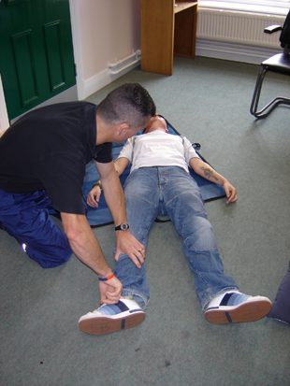
First Aid & CPR Secondary Survey

Slide 2
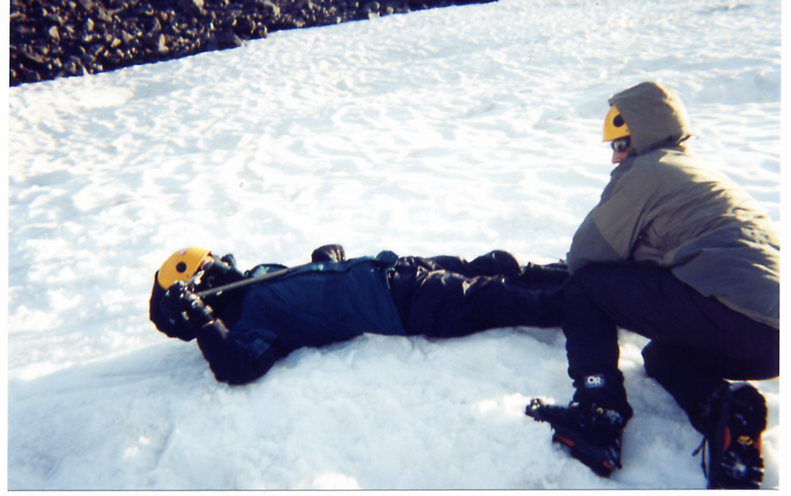
Secondary Survey
Head to Toe Survey

Slide 3
Secondary Survey
Students will learn what to do after the Primary Survey is complete
Students will be able to perform the Secondary Survey

Slide 4
Secondary Survey
When Life threatening conditions have been controlled
Start Secondary Survey
Head – to – Toe Survey
Done quickly @ 90 seconds

Slide 5
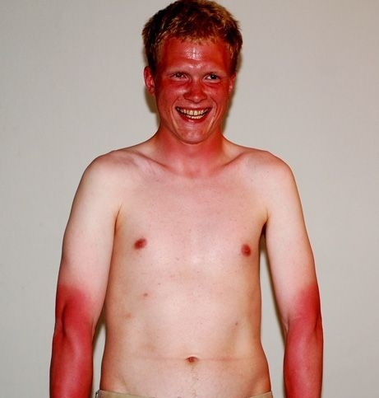
Secondary Survey
Examine Skin Color

Slide 6
Secondary Survey
Scalp
Lacerations
Do NOT
Move Head

Slide 7
Secondary Survey
Scalp
Contusions

Slide 8
Secondary Survey
Skull
Depressions
Feel softly

Slide 9
Seconday Survey
Eyes “PEARL”
Pupils
Equal
And
Reactive to
Light

Slide 10
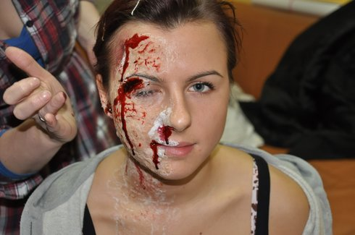
Seconday Survey
Check
Ears
Nose
Mouth
For Fluids

Slide 11
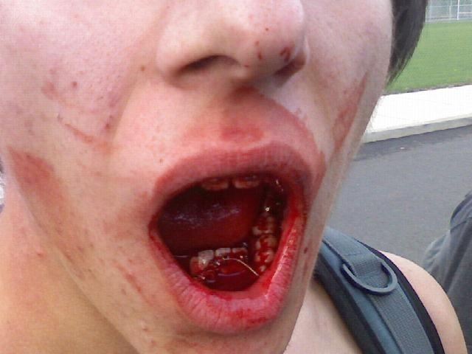
Seconday Survey
Objects in Mouth
Obstructions (Teeth)

Slide 12
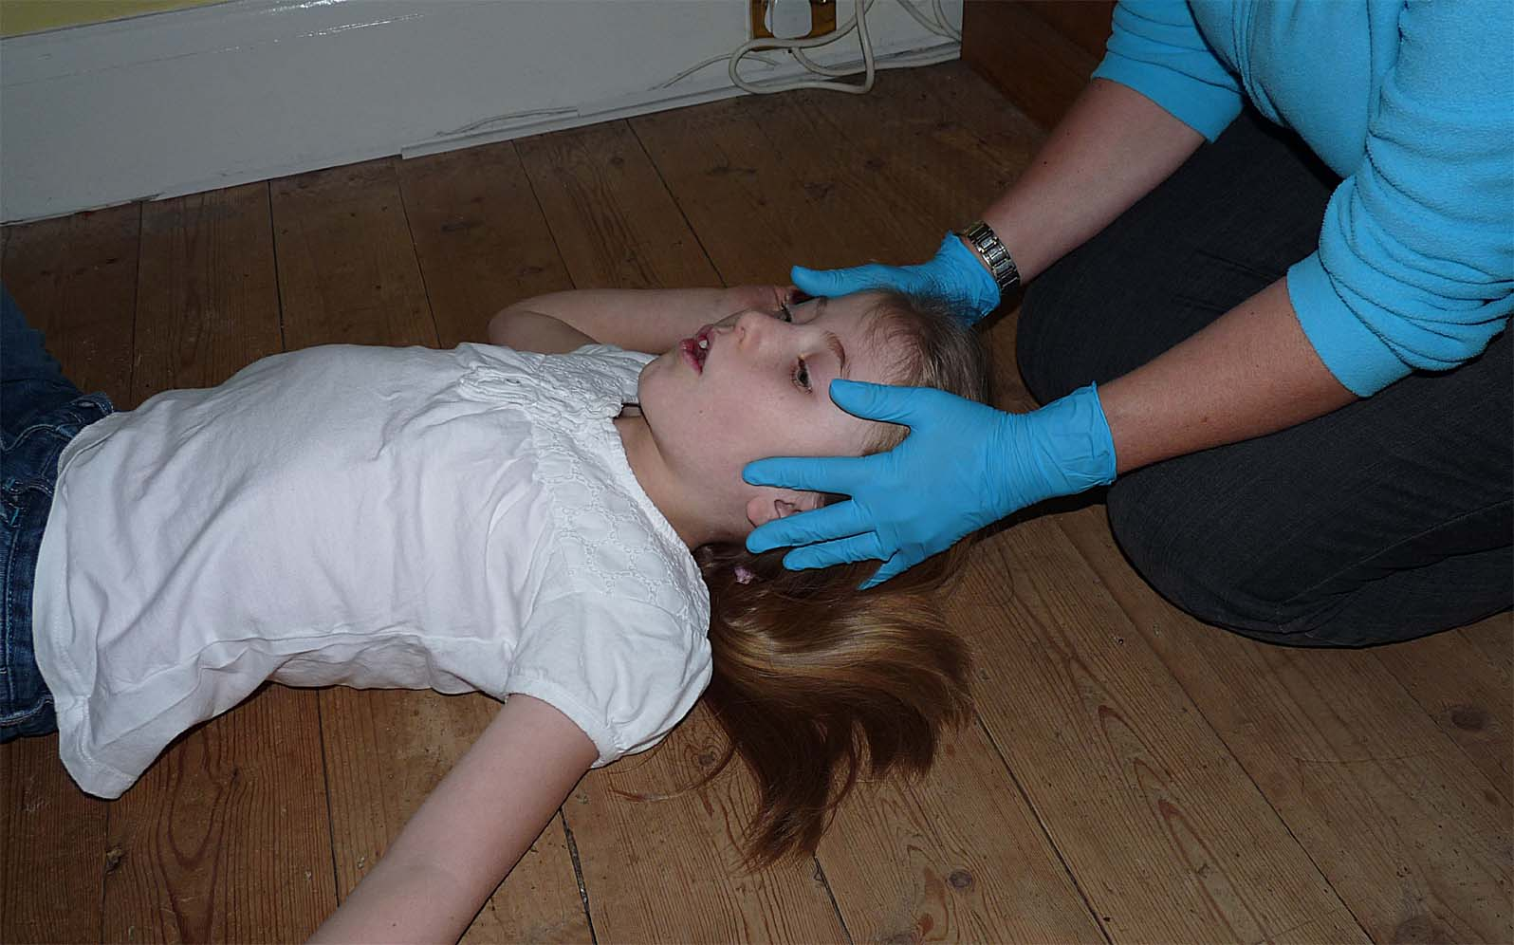
Seconday Survey
Spine
Feel Gently If Spine Injury
STOP
and Immobilize

Slide 13
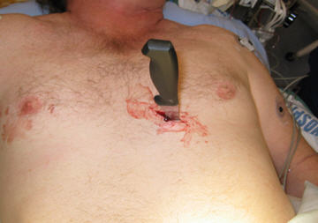
Secondary Survey
Chest Wounds
Observe
chest movements

Slide 14
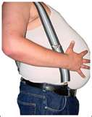
Secondary Survey
Abdominal Tenderness - Press gently

Slide 15
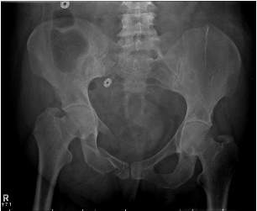
Secondary Survey
Pelvic Area
Gentle pressure on Iliac Crest

Slide 16
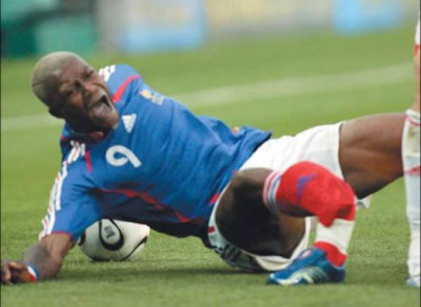
Secondary Survey
Extremities
Deformities
Sensation of Extremities
Conscious
Wiggle Toes and Fingers
Rub a finger on Skin
Pinch

Slide 17
Secondary Survey
Unconscious
Stroke Palm of Hand and Sole of Feet

Slide 18
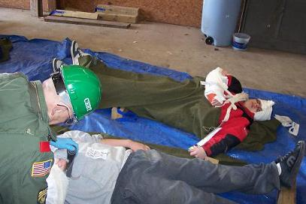
Secondary Survey
Monitor Victim
ABC’s
Medic Alert Tags
Start taking care of any injuries

Slide 19
Secondary Survey
Volunteer to lay on floor to demonstrate Primary Survey
Now make it challenging

Slide 20
Secondary Survey
Get in groups of 3
Practice the Primary Survey
1 person victim
1 person First Responder
1 person Coach / Educator
Start flat on back
Then make it challenging

